Slide 1

LAB: My First Cluster with MongoDB Atlas!
Jay Gordon
Developer Advocate - NYC
@jaydestro – jay.gordon@mongodb.com
Notes:
Intro the lab

Slide 2
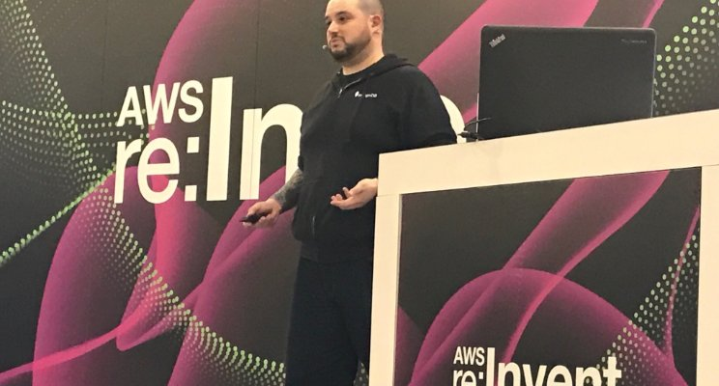
Jay Gordon
Developer Advocate - NYC
@jaydestro – jay.gordon@mongodb.com
Jay Gordon
Developer Advocate - NYC
@jaydestro
Notes:
Intro myself

Slide 3
Required for Lab
Basic understanding of distributed systems and cloud computing
APIs
Virtual Machines
Basic Understanding of HTTP PUT/GET
Knowledge of AWS/Azure/Google Compute
Computer
Administrative permissions (Windows, OSX, or Linux) Command line experience
Jay Gordon
Developer Advocate - NYC @jaydestro
Notes:
Explain appropriate materials and knowledge to begin the lab.

Slide 4



Let’s Meet MongoDB
Open source
Distributed
High performance
Scalable
Notes:
MongoDB is a document DB, open source, distributred, high performance and scalable.

Slide 5















Drivers & Frameworks
MEAN Stack
Morphia
Notes:
Idiomatic drivers, web frameworks to begin working with

Slide 6

Operations Burden
PATCHES
UPGRADES
SECURITY
BACKUPS
RECOVERY
99.999% UPTIME
UPSCALE
DOWNSCALE
PERFORMANCE
UAT
STAGING
MONITORING
ALERTS
PROVISION
CONFIGURE
INSTALL
Notes:
DBAs/DevOps/SysAdmins – All of these people have so many concerns that go beyond just data creation. This leaves us with a pretty large black hole to fill in order to reduce overhead.

Slide 7

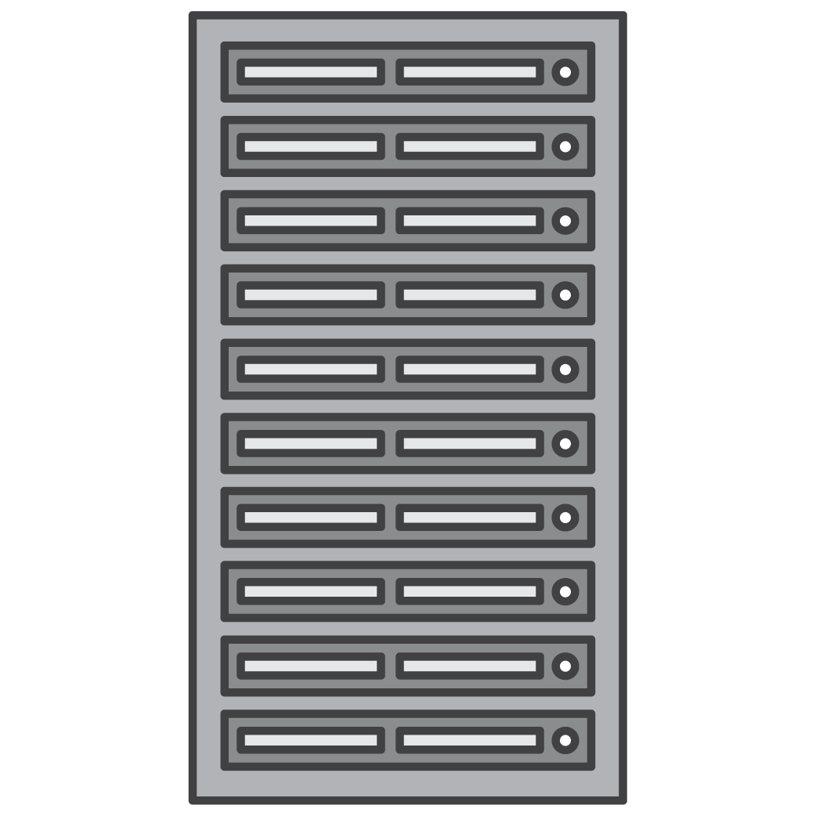

Helping you deploy in any environment
Ops Manager
Cloud Manager
MongoDB Atlas
data: on-prem or cloud
ops: on-prem or cloud
data: on-prem or cloud
ops: cloud
Fully Managed Cloud
Control
Convenience
Notes:
Ops Manager allow all control of env
Cloud Manager permits to run management on Cloud
Atlas is fully managed for all features related to security, provisioning and automation

Slide 8
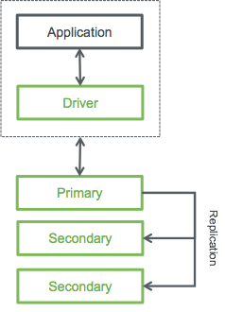
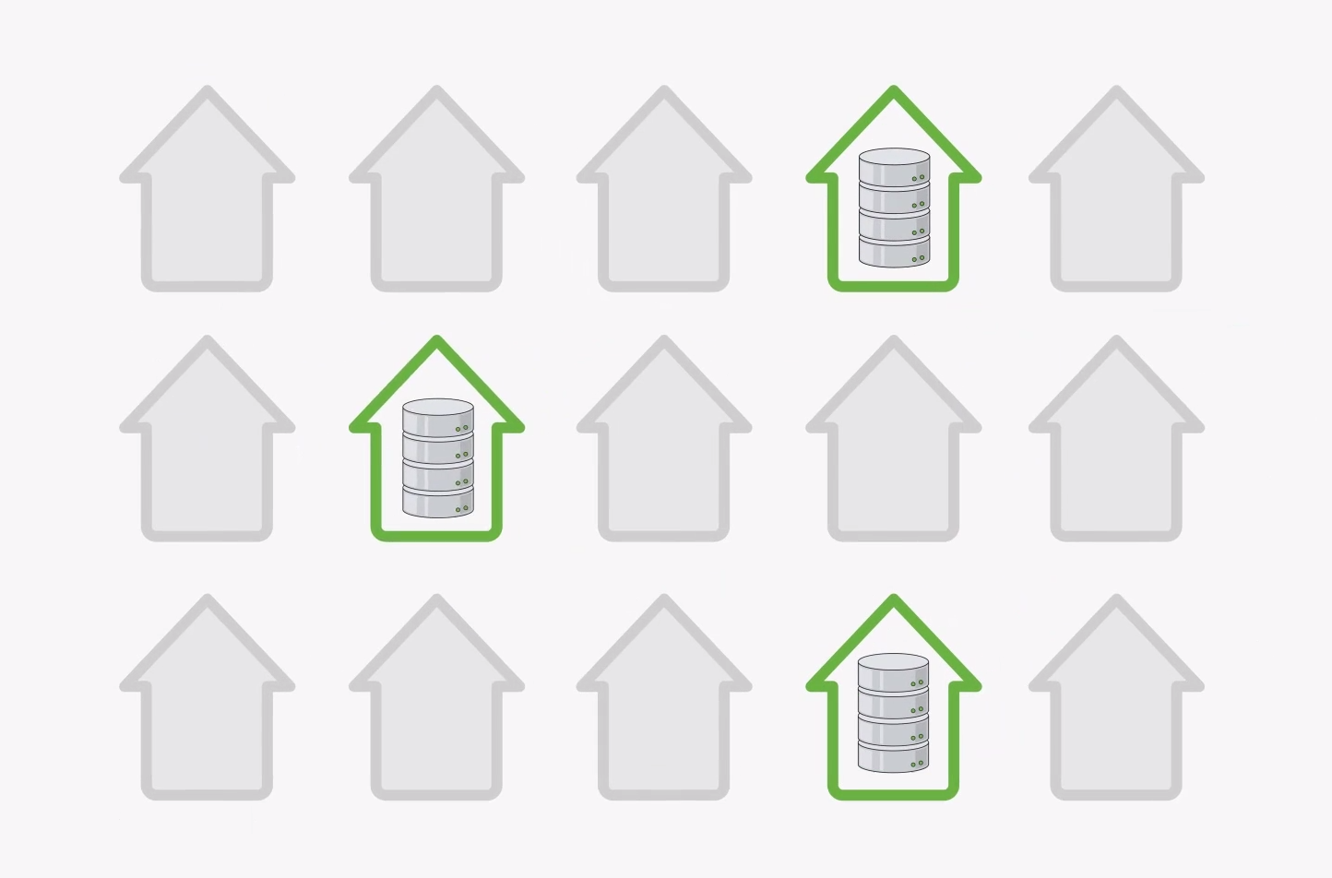
Highly Available by Default
Under the hood
Three node for prod standard
Self healing
Redundant
Notes:
Atlas is self healing. If a node goes down, there’s no need for you to change anything, we’ll replace it on the back end automatically without any intervention on your side required. Your connection string, your network settings, all of this remains the same.

Slide 9
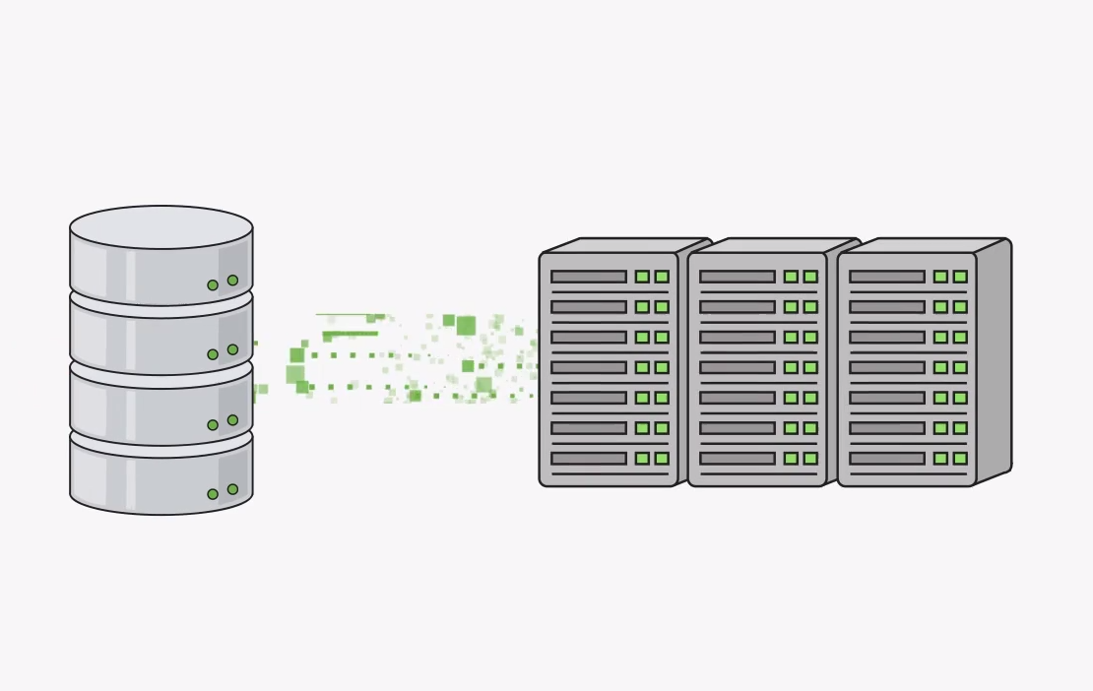
Continuous Backup / Point-in-time Restore
Under the hood
Snapshots every 6 hours
Point-in-time backup of replica
Pay-as-you-go
Set up at any time
Notes:
Backups - Always available

Slide 10
Install MongoDB 3.4 and Register for Atlas.
Go to https://mongodb.com/download in browser
Select “Community Server”
Select operating system version and follow instructions on installation.
Go to https://cloud.mongodb.com/ and sign up for Atlas
Notes:
install the software required

Slide 11
Let’s verify our shell is installed
Execute from your command line:
mongo --version MongoDB shell version v3.4.0
git version: f4240c60f005be757399042dc12f6addbc3170c1
OpenSSL version: OpenSSL 1.0.2k 26 Jan 2017
allocator: system
Notes:
validate our shell install

Slide 12
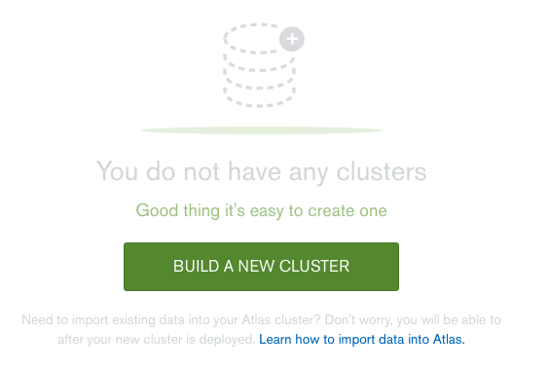
Sign into Atlas and launch free M0
Notes:
sign up for atlas and launch cluster

Slide 13
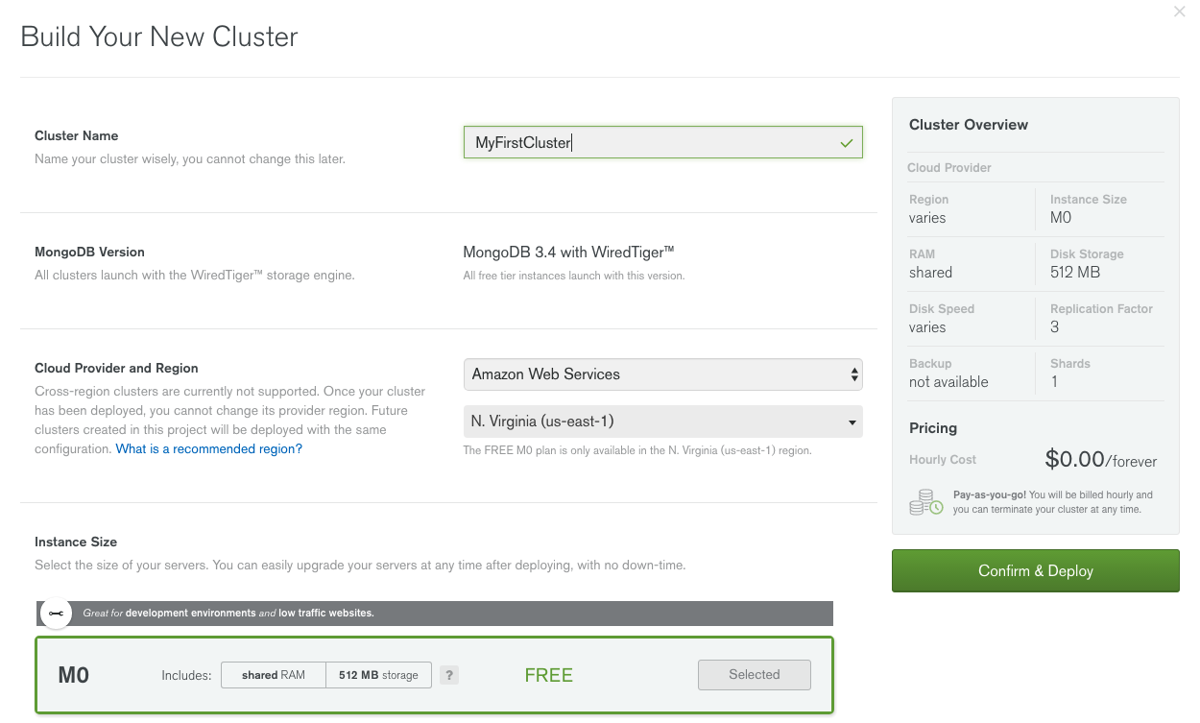
Notes:
notes on config

Slide 14
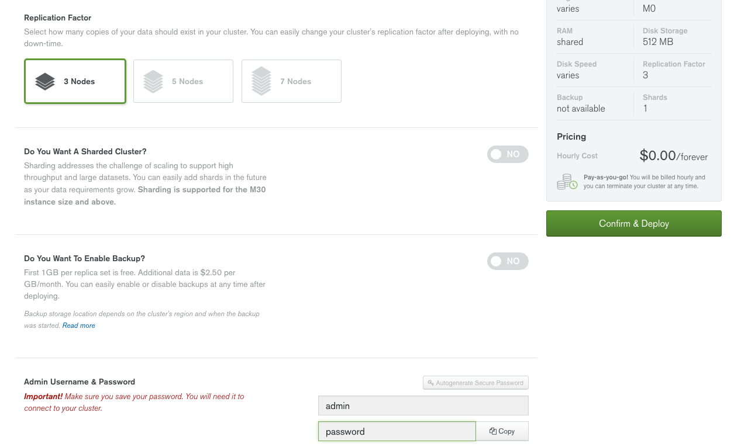
Notes:
notes on config

Slide 15
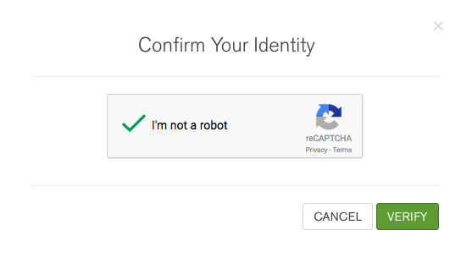
Notes:
confirm we are human

Slide 16
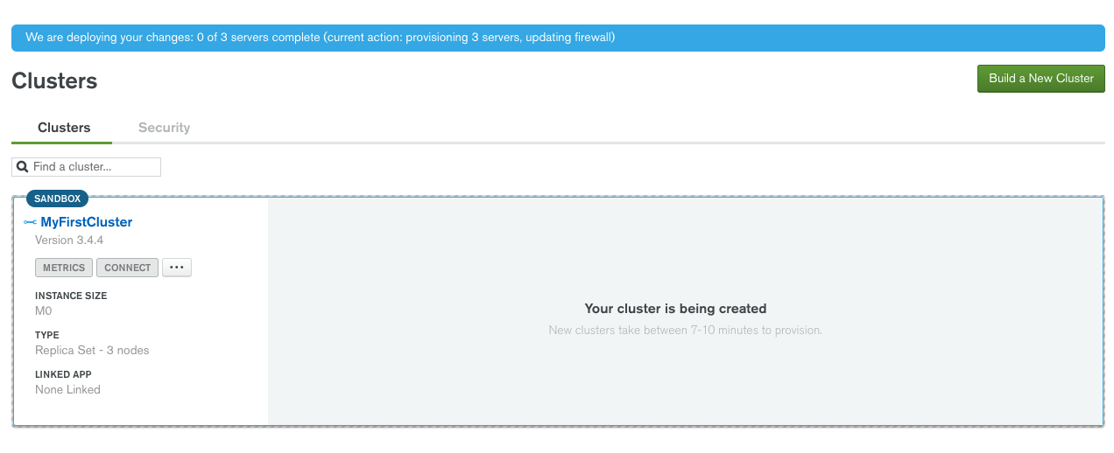
Cluster Build takes about 5 minutes.
Notes:
allow time to build the free cluster

Slide 17
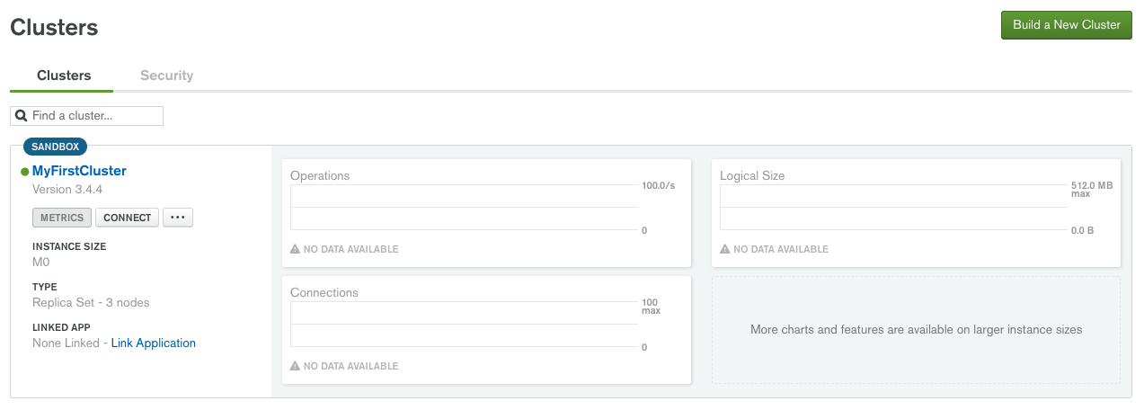
Ready cluster should look like this:
Notes:
when completed

Slide 18
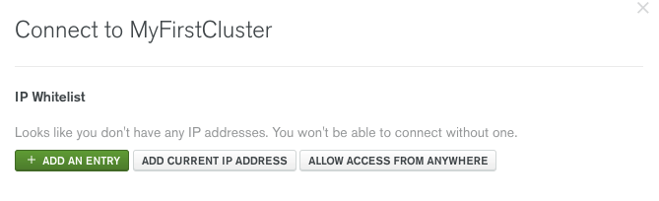
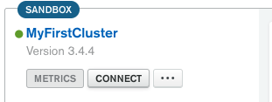
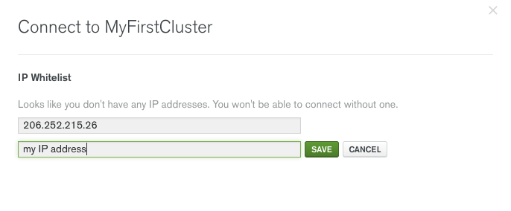
Whitelist IP
Notes:
whitelist of inbound connections from our laptops

Slide 19
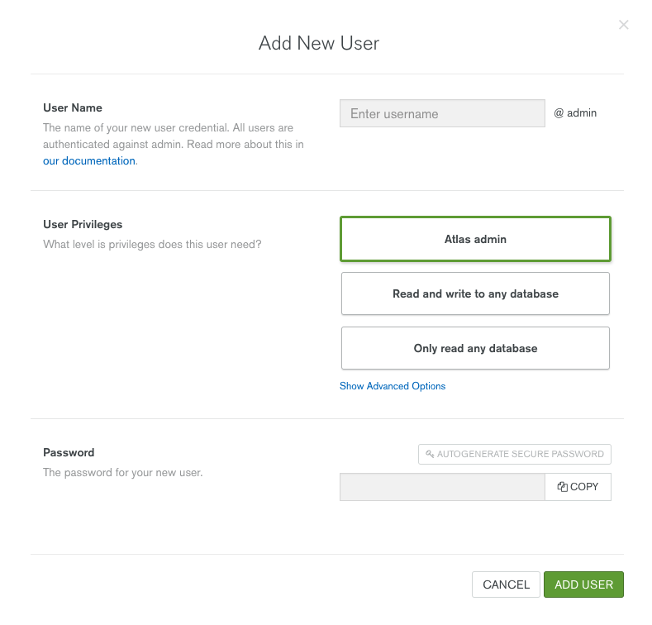
User accounts
You should have created a username and password at creation time
You can create additional users with specific roles if needed.
These users cannot log into Atlas, they are for accessing MongoDB Database.
Notes:
user account authorization and access

Slide 20
Notes:
how to get our connection string for our shell

Slide 21
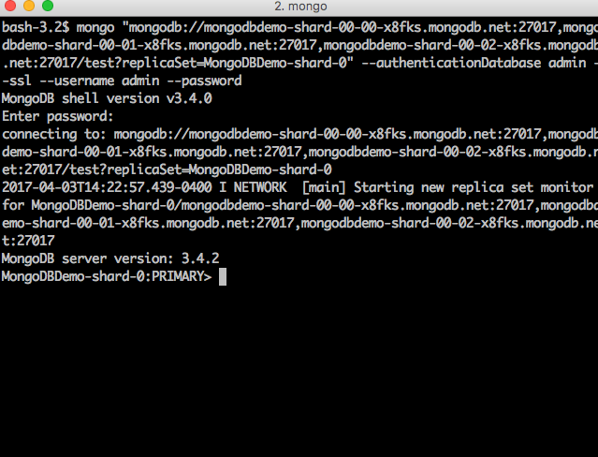
Paste into your command shell!
Notes:
the view from our shell

Slide 22
Create your first document
Create the database: MyFirstCluster-shard-0:PRIMARY> use mongodblab
switched to db mongodblab
Create the document: MyFirstCluster-shard-0:PRIMARY> db.firstdoc.insert({"Database Name" : "MongoDB"})
WriteResult({ "nInserted" : 1 })
Notes:
create db and add a document

Slide 23
View your data
List your Databases:
MyFirstCluster-shard-0:PRIMARY> show databases
admin 0.000GB
local 3.806GB
mongodblab 0.000GB List your collections: MyFirstCluster-shard-0:PRIMARY> show collections
firstdoc
Notes:
show documents and collections

Slide 24
View your data
List your document:
Cluster0-shard-0:PRIMARY> db.firstdoc.find().pretty()
{ "_id" : ObjectId("58fbccd1476946a2f80b0a26"), "Database Name" : "MongoDB" }
Notes:
list document

Slide 25
Download your Zips Example Data
http://media.mongodb.org/zips.json
bash-3.2$ ls -al zips.json
-rw-r--r-- 1 jaygordon staff 3182409 Jul 7 2014 zips.json
Notes:
download zips for import

Slide 26
Review your Zips Example Data
{ "_id" : "01001", "city" : "AGAWAM", "loc" : [ -72.622739, 42.070206 ], "pop" : 15338, "state" : "MA" }
{ "_id" : "01002", "city" : "CUSHMAN", "loc" : [ -72.51564999999999, 42.377017 ], "pop" : 36963, "state" : "MA" }
{ "_id" : "01005", "city" : "BARRE", "loc" : [ -72.10835400000001, 42.409698 ], "pop" : 4546, "state" : "MA" }
{ "_id" : "01007", "city" : "BELCHERTOWN", "loc" : [ -72.41095300000001, 42.275103 ], "pop" : 10579, "state" : "MA" }
{ "_id" : "01008", "city" : "BLANDFORD", "loc" : [ -72.936114, 42.182949 ], "pop" : 1240, "state" : "MA" }
Notes:
explain data, data structure

Slide 27
Import your Zips Data into Atlas Primary
mongoimport --host $PRIMARYHOSTNAME-shard-00-00-x8fks.mongodb.net:27017 --db zips --type json --file ~/zips.json --authenticationDatabase admin --ssl --username $USERNAME -–password $PASSWORD
2017-04-03T16:52:33.565-0400 imported 29353 documents
Notes:
import, explain how mongoimport provides a way to import json ready file types with delimiters or headers

Slide 28
View your data
List your Databases:
MongoDBDemo-shard-0:PRIMARY> show databases
admin 0.000GB
local 3.811GB
mongodblab 0.000GB
zips 0.002GB List your collections: MongoDBDemo-shard-0:PRIMARY> use zips
switched to db zips
Notes:
view our new data

Slide 29
Demo - Watch me add Atlas to NodeJS app
https://scotch.io/tutorials/creating-a-single-page-todo-app-with-node-and-angular
https://github.com/scotch-io/node-todo
Notes:
view with pretty print

Slide 30
What’s Next?
Compass – Visualization Tool
Advanced Queries
Review paid features such as backups and peering
Tell us about what you learn!
Join our Advocacy Hub
https://advocacy.mongodb.com Join MongoDB University
https://university.mongodb.com
Jay Gordon
Developer Advocate - NYC @jaydestro
Notes:
Next steps descriptions - What after today?

